Slide 1
Tuesday, August 15, 2017
Write In Your Agenda:
Write In Your Monitoring Log:
CW:
Finish Density notes
Review Metric System Conversion worksheet
Metric System Poof Book
HW:
“Do Your Metric System Skills Measure Up?” worksheet.
Response to Warm-Up:
What does the density of an object tell you about the object?
You will need:
Pencil
Agenda
Monitoring Log
Diving Deeper Into Density Notes

Slide 2
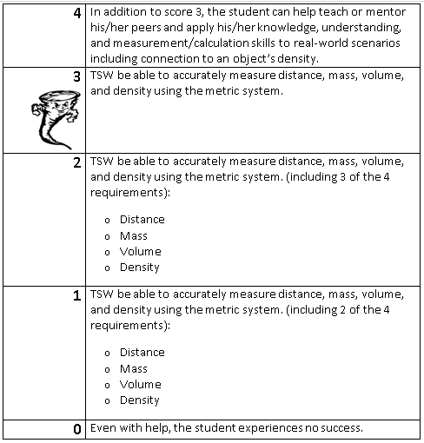
Learning Goal and Scale
TSW be able to describe how the Earth is connected to and affected by other objects in the solar system (including its movement, its relative position to other objects, its seasons, and visible constellations).

Slide 3
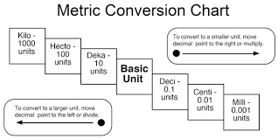

Slide 4
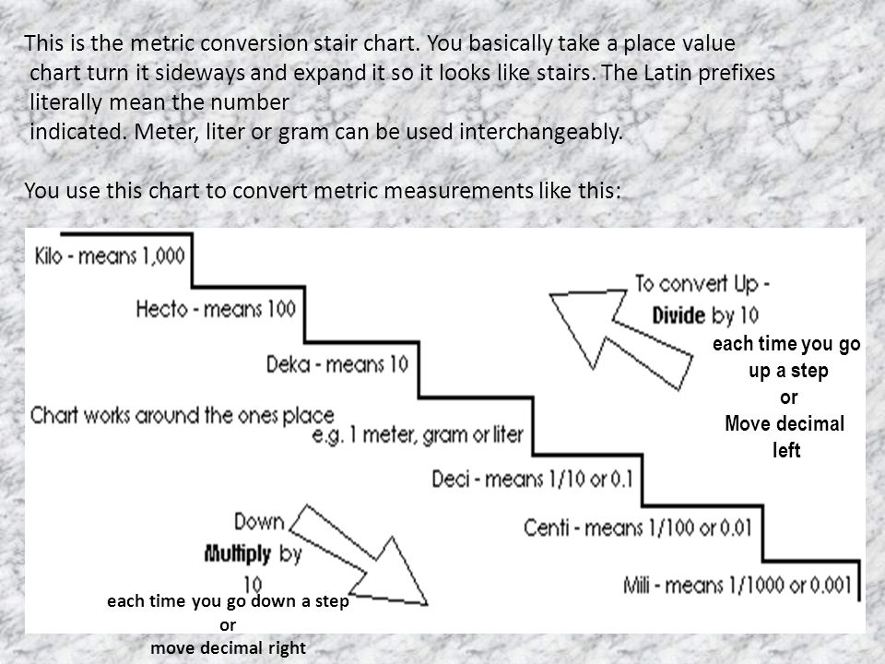

Slide 5
